Slide 1
Unit 5
Disk Scheduling

Slide 2
Overview of Mass Storage Structure
Magnetic disks provide bulk of secondary storage of modern computers
  Drives rotate at 60 to 200 times per second
  Transfer rate is rate at which data flow between drive and computer
  Positioning time (random-access time) is time to move disk arm to desired cylinder (seek time) and time for desired sector to rotate under the disk head (rotational latency)
  Head crash results from disk head making contact with the disk surface
Disks can be removable
Drive attached to computer via I/O bus
  Busses vary, including EIDE, ATA, SATA, USB, Fibre Channel, SCSI
  Host controller in computer uses bus to talk to disk controller built into drive or storage array

Slide 3
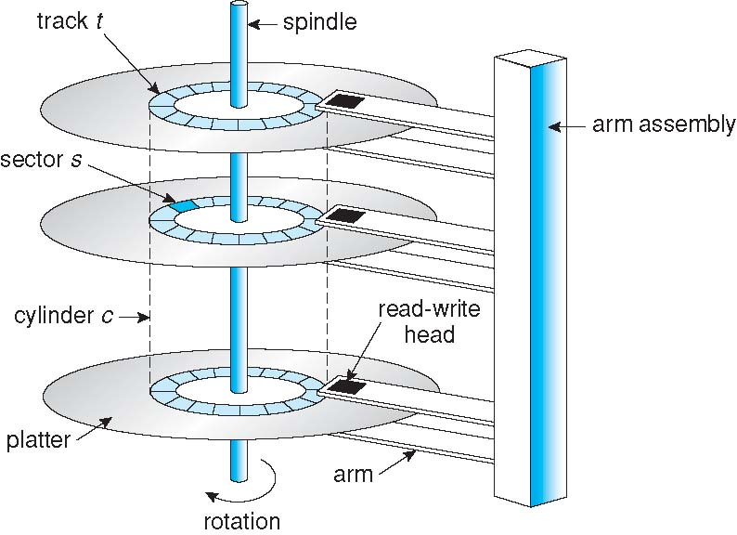
Moving-head Disk Mechanism

Slide 4
Disk Scheduling
The operating system is responsible for using hardware efficiently — for the disk drives, this means having a fast access time and large disk bandwidth.
Access time has two major components
  Seek time is the time for the disk arm to move the heads to the cylinder containing the desired sector
  Rotational latency is the additional time waiting for the disk to rotate the desired sector to the disk head
Minimize seek time
Seek time ≈ seek distance
Disk bandwidth is the total number of bytes transferred, divided by the total time between the first request for service and the completion of the last transfer

Slide 5
Types of Disk Scheduling
FCFS : First Come First Serve
SSTF : Shortest Seek Time First
SCAN
C-SCAN : Circular SCAN
LOOK
C-LOOK : Circular LOOK

Slide 6
Cont…
Question:
      Total number of cylinder=5000[0-----4999]
      Header=143
      Previous Request=125{Direction of Line}
Request: 86,1470,913,1774,948,1509,1022,1750,130
Solution:
Refer Class notes

Slide 7
Disk Scheduling (Cont.)
Several algorithms exist to schedule the servicing of disk I/O requests
We illustrate them with a request queue (0-199)
98, 183, 37, 122, 14, 124, 65, 67
Head pointer 53

Slide 8
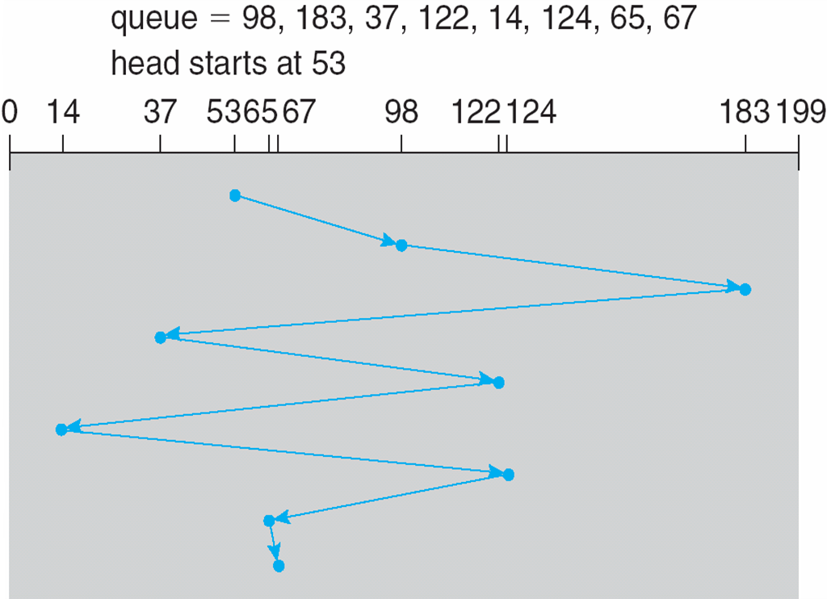
FCFS
Illustration shows total head movement of 640 cylinders

Slide 9
SSTF
Selects the request with the minimum seek time from the current head position
SSTF scheduling is a form of SJF scheduling; may cause starvation of some requests
Illustration shows total head movement of 236 cylinders

Slide 10
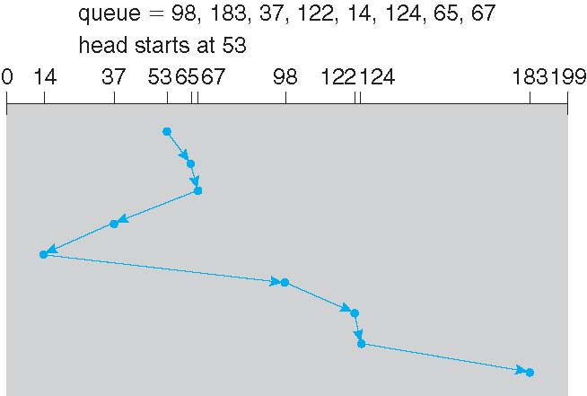
SSTF (Cont.)

Slide 11
SCAN
The disk arm starts at one end of the disk, and moves toward the other end, servicing requests until it gets to the other end of the disk, where the head movement is reversed and servicing continues.
SCAN algorithm Sometimes called the elevator algorithm
Illustration shows total head movement of 208 cylinders

Slide 12
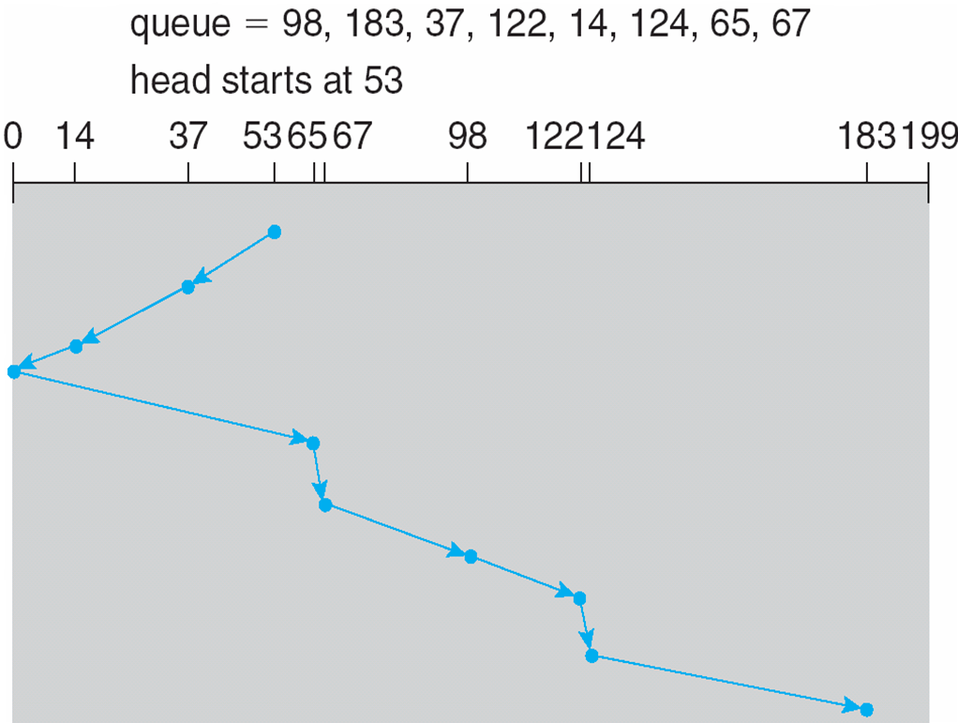

Slide 13
C-SCAN
Provides a more uniform wait time than SCAN
The head moves from one end of the disk to the other, servicing requests as it goes
  When it reaches the other end, however, it immediately returns to the beginning of the disk, without servicing any requests on the return trip
Treats the cylinders as a circular list that wraps around from the last cylinder to the first one

Slide 14
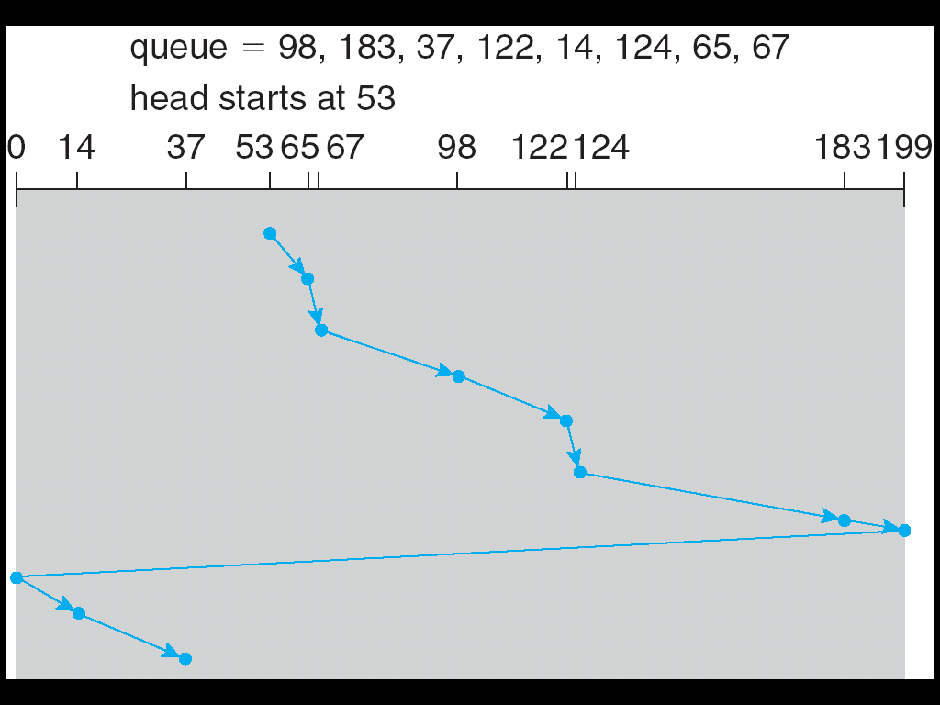
C-SCAN (Cont.)

Slide 15
C-LOOK
Version of C-SCAN
Arm only goes as far as the last request in each direction, then reverses direction immediately, without first going all the way to the end of the disk

Slide 16
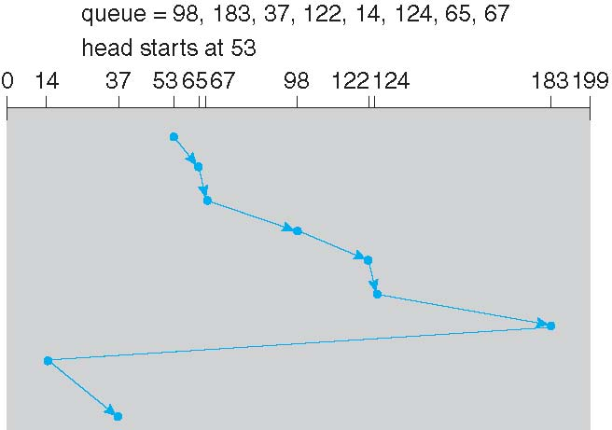
C-LOOK (Cont.)

Slide 17
Selecting a Disk-Scheduling Algorithm
SSTF is common and has a natural appeal
SCAN and C-SCAN perform better for systems that place a heavy load on the disk
Performance depends on the number and types of requests
Requests for disk service can be influenced by the file-allocation method
The disk-scheduling algorithm should be written as a separate module of the operating system, allowing it to be replaced with a different algorithm if necessary
Either SSTF or LOOK is a reasonable choice for the default algorithm

Slide 18
Disk Management
Low-level formatting, or physical formatting — Dividing a disk into sectors that the disk controller can read and write
To use a disk to hold files, the operating system still needs to record its own data structures on the disk
  Partition the disk into one or more groups of cylinders
  Logical formatting or “making a file system”
  To increase efficiency most file systems group blocks into clusters
    Disk I/O done in blocks
    File I/O done in clusters
Boot block initializes system
  The bootstrap is stored in ROM
  Bootstrap loader program
Methods such as sector sparing used to handle bad blocks

Slide 19


Slide 20
Syllabus
PROGRAMME: B.E. INFORMATION TECHNOLOGY, V ISEMESTER
IT- 504 – System Programming & Operating Systems
Unit I
Introduction Language Processors, Language Processing Activities and Language Processors Development Tools, Assemblers, Compiler, Macros and Macro Processors, Linkers, Software Tools . Introduction to Operating Systems, Types of operating Systems, system protection, Operating system services.
Unit II
Basic concepts of CPU scheduling, Scheduling criteria, Scheduling algorithms, algorithm evaluation, multiple processor scheduling. Process concept, operations on processes, threads, interprocess communication, precedence graphs, critical section problem, semaphores, classical problems of synchronization,
Unit III
Deadlock problem, deadlock characterization, deadlock prevention, deadlock avoidance, deadlock detection, recovery from deadlock, Methods for deadlock handling. Concepts of memory management, logical and physical address space, swapping, Fixed and Dynamic Partitions, Best-Fit, First-Fit and Worst Fit Allocation, paging, segmentation, and paging combined with segmentation.
Unit IV
Concepts of virtual memory, Cache Memory Organization, demand paging, page replacement algorithms, allocation of frames, thrashing, demand segmentation, Role of Operating System in Security, Security Breaches, System Protection, and Password Management.
Unit V
Disk scheduling, file concepts, File manager, File organization, access methods, allocation methods, free space managements, directory systems, file protection, file organization & access mechanism, file sharing implement issue, File Management in Linux, introduction to distributed systems.

Slide 21


